Slide 1
Introduction to Real-Time Systems
:
Chap1
RAJIB MALL
Professor
Department Of Computer Science & Engineering
IIT Kharagpur.

Slide 2
Organization
  Introduction
  Example Applications of Real-Time Systems
  Basic Model of a Real-Time System

Slide 3
Introduction
Real-time systems are finding increasing applications
According to a recent estimate,
  the number of computers deployed in real-time applications vastly out number those in ordinary applications.
  Many of these computers are embedded.

Slide 4
What is Real-time?
Real-time is a quantitative notion of time measured using a physical clock.
  e.g after an event occurs (temperature exceeds 500 degrees) the corresponding action (coolant shower) must complete within 100mSec.
This is in contrast to the qualitative notion of time
  Expressed using notions such as before, after, sometime, eventually, etc.

Slide 5
What is a Real-Time System?
A system is called real-time
  Whenever we need to quantitatively express time in order to describe its behaviour.
  Remember that the behavior of a system is described by listing the inputs to the system and the corresponding response of the systems.

Slide 6
Example Applications of Real-Time Systems
Industrial applications
  process control systems,
  industrial automation systems,
  SCADA applications,
  test and measurement equipments, and
  robotic equipments

Slide 7
Example Applications of Real-Time Systems cont…
Telecommunication Applications:
  cellular systems,
  video conferencing, and
  cable modems

Slide 8
Example Applications of Real-Time Systems cont…
Aerospace:
  avionics,
  flight simulation,
  Airline cabin management systems,
  satellite tracking systems,
  computer on-board an aircraft

Slide 9
Example Applications of Real-Time Systems cont…
Consumer electronics:
  set-top boxes,
  audio equipment,
  Internet telephony,
  microwave ovens,
  intelligent washing machines,
  home security systems,
  air conditioning and refrigeration,
  toys, and cell phones

Slide 10
Other Applications
  Medical
    Robot Used in Recovery of Displaced Radioactive Material
  Peripheral Equipments
    Laser Printer
  Transportation
    Multi-Point Fuel Injection (MPFI) System

Slide 11
Other Applications
  Computers and Internet
  Multimedia Applications
    Video Conferencing
  Defence Applications
    Missile Guidance System

Slide 12
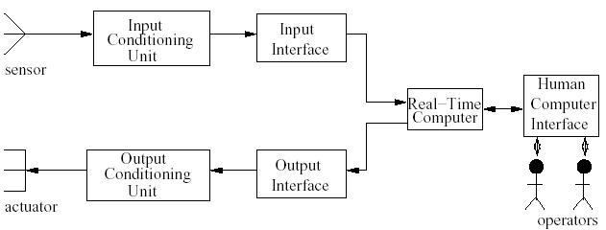
Basic Model of a Real-Time System

Slide 13
Sensors
A sensor converts some physical characteristic
of its environment into electrical signals.
Example sensors:
  a photo-voltaic cell converts light energy into electrical energy.
  A temperature sensor typically operates based on the principle of a thermocouple
  A pressure sensor typically operates based on the piezoelectricity principle.

Slide 14
Actuators
An actuator takes converts electrical signals from a computer into some physical actions.
The physical actions may be
  motion, change of thermal, electrical, pneumatic, or
  physical characteristics of some objects.
Example actuators are:
  Motors
  Heaters
  Hydraulic and pneumatic actuators

Slide 15
Signal Conditioning
Analog signals generated by a photo-voltaic cell are normally in the milli volts range
  need to be conditioned before they can be processed by a computer
Important types of conditioning:
  Voltage Amplification
  Voltage Level Shifting
  Frequency Range Shifting and Filtering
  Signal Mode Conversion

Slide 16
Characteristics of Real-Time System
  Time Constraints
    Every real-time task is associated with some time constraints ex. deadline
  Correctness Criterion
    Correctness implies not only logical correctness of results but the time at which it is produced
  Embedded
    Large number of real-time systems are embedded in its environment and often controls it
  Safety and Task Criticality
    For many real-time systems, safety and reliability are bound together which makes them safety-critical

Slide 17
Characteristics of Real-Time System
  Concurrency
    RT system needs to respond to several independent events
  Distributed and Feedback Structure
  Custom Hardware
    A RT system is often implemented on custom H/W that is specially designed and developed for the purpose
  Reactive
    On-going interaction between computer and environment
  Stability
    Work under overload conditions for important tasks
  Exception Handling

Slide 18
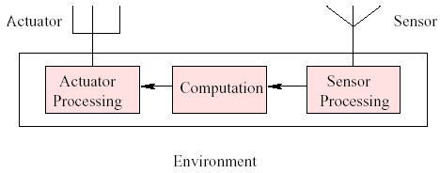
Characteristics of Real-Time System
Feedback structure of real-time systems

Slide 19
Safety and Reliability in RT System
  Independent concepts in traditional system
  Interrelated in safety-critical systems
    Safety critical system is one for which any failure of the system would result in damage.
  Safety can be ensured through increased reliability
  Safety-critical system should be highly reliable
  Example: A navigation system on-board an aircraft. Such system does not have fail-safe states

Slide 20
Fail-safe State
A fail-safe state of a system is one which if entered when the system fails,
  no damage would result
The fail-safe state of a word processing
program:
  the document being processed has been saved onto the disk
fail-safe states help separate the issues of safety and reliability
  even if a system is known to be unreliable, it can always be made to fail in a fail-safe state,

Slide 21
Safety-Critical System
A safety-critical system is one whose failure can cause severe damages
A safety-critical system does not have any fail-safe states:
  safety can only be ensured through increased reliability

Slide 22
Achieving High Reliability in Real-Time System
  Error Avoidance
  Error Detection and Removing
  Fault Tolerance

Slide 23
Fault Tolerance in RT System
  Hardware
    Built in self test (BIST)
    Triple modular redundancy
  Software
    N-Version programming
    Recovery Blocks

Slide 24
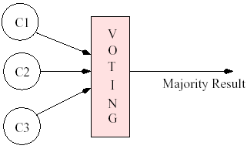
Triple Modular Redundancy
C1, C2 and C3 are redundant copies of same component

Slide 25
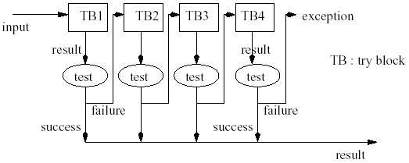
Recovery Blocks
Software Fault Tolerance using recovery blocks

Slide 26
Types of Real-Time Systems
Real-time systems are different from the traditional systems
Tasks have deadlines associated with them
  Hard real-time systems
  Soft real-time systems
  Firm real-time systems

Slide 27
Hard Real-Time Systems
If a deadline is not met,
  then the system is said to have failed
  The task deadlines are of the order of micro or milliseconds
  Many hard real-time systems are safety-critical
Examples
  Industrial control applications
  On-board computers
  Robots

Slide 28
Firm Real-Time Systems
Tasks have deadlines
  If a deadline is missed occasionally, the system does not fail
  The results produced by a task after the deadline are rejected
Utility
D
Time

Slide 29
Firm Real-Time Systems
Examples
  A video conferencing application
  A telemetry application
  Satellite-based suveillance applications

Slide 30
Soft Real-Time Systems
Tasks have deadlines
  If a deadline is missed, the system does not fail.
  The performance of the system is said to have degraded
  The utility of a result decreases with time after the deadline
Utility
D
Time

Slide 31
Soft Real-Time Systems
Examples of soft real-time systems:
  Railway reservation system
  Web browsing
  In fact, all interactive applications

Slide 32
Summary
A system is said to be real-time when
  quantitative expressions of time are
  necessary to describe the behavior of the system
A real-time task is one that is associated with some time constraints
A real-time task is classified into hard, firm, or soft real-time type
  depending on the consequences of a task failing to meet its timing constraints

Slide 33
Summary
A safety-critical system is one which does not have a fail-safe state
  any failure of the system can cause severe damage.
  Many hard real-time systems are safety-critical in nature
The typical characteristic features of a hard real-time system include
  embedded, feedback and distributed structure,
  and safety-criticality.

